Slide 1
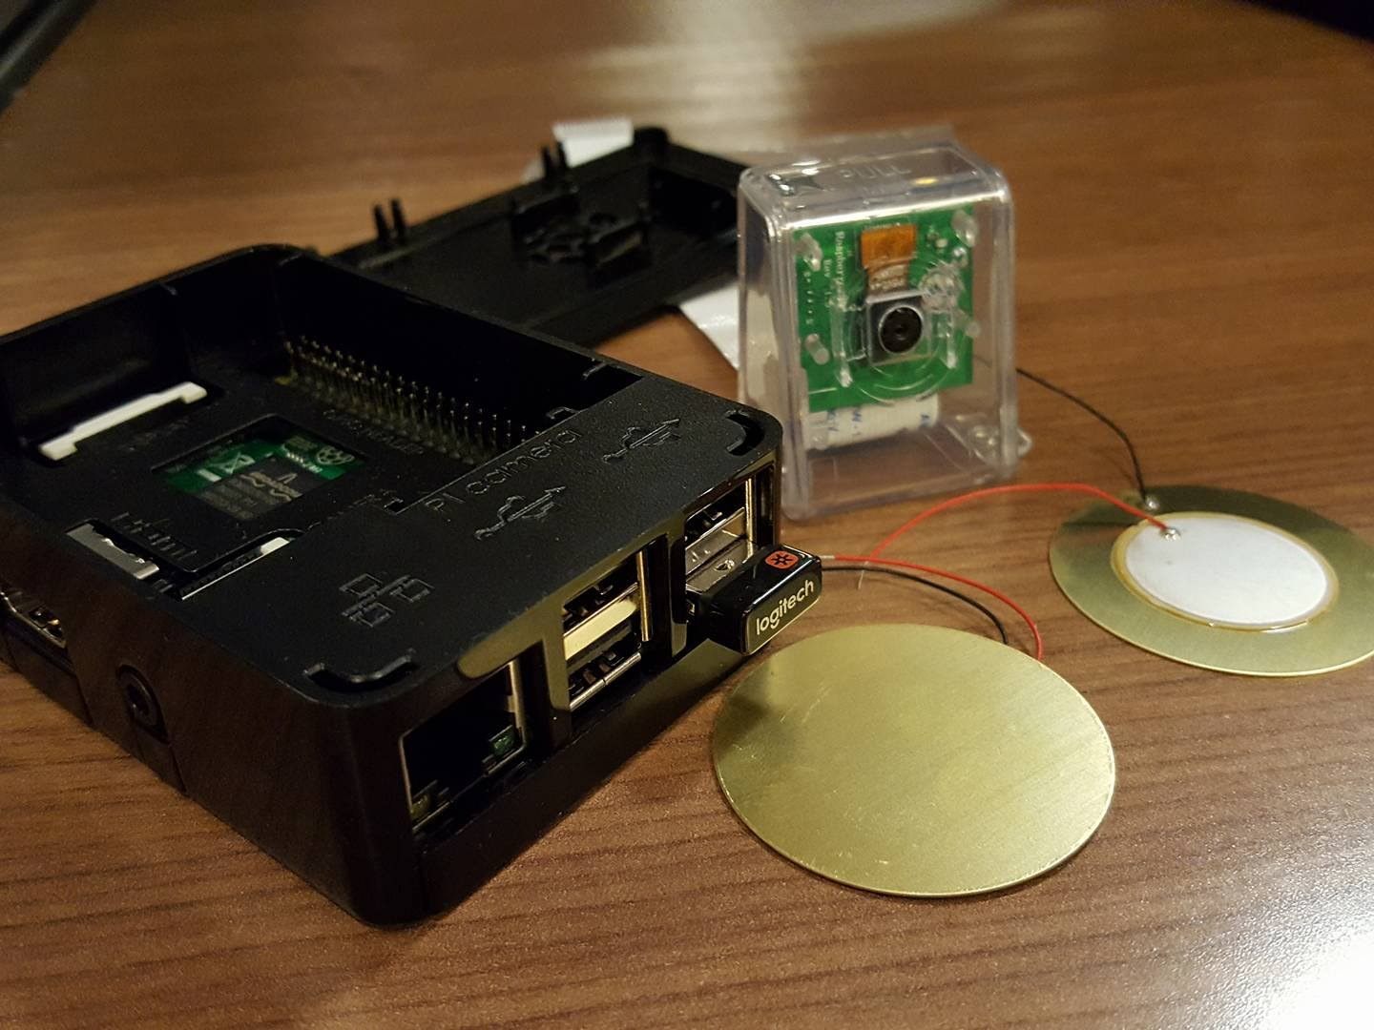
Telematics
By: Jerome Aganon

Slide 2
Content
Proposal
Budget
Schedule
Build Video
Course knowledge utilized from previous course

Slide 3
Proposal:Background
Car has been part of our daily life.
Based on National Safety Council, around 27,000 accidents occur everyday.
According to provincial law, any accident that has less than $2000 estimated damage does not require police.

Slide 4
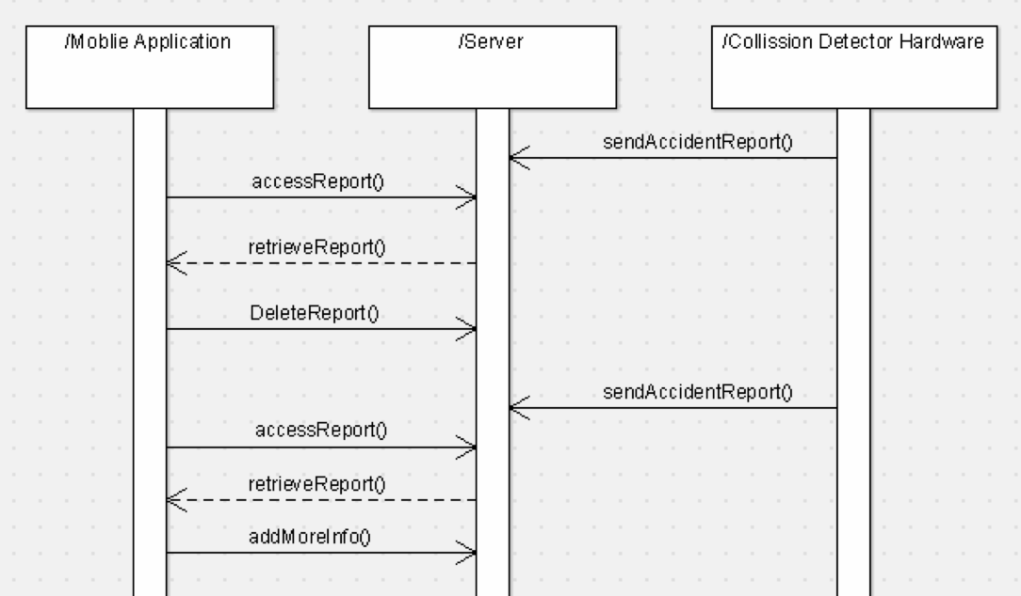
Proposal:Solution
We are going to build a collision detector.
It uses vibration sensor to detect the collision.
It uses raspberry pi camera to record the collision.

Slide 5
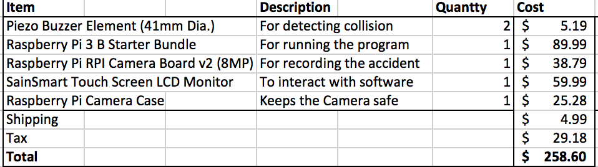
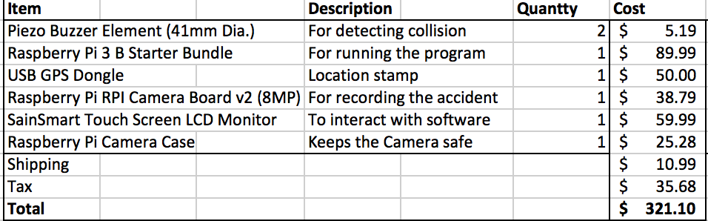
Budget
Estimated
Actual

Slide 6
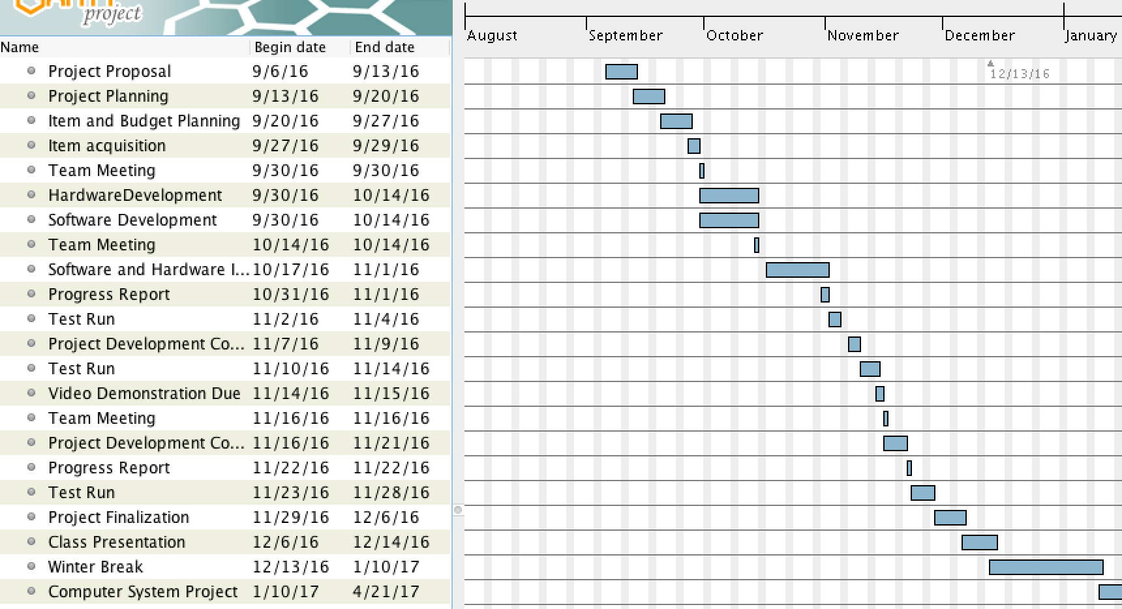
Schedule

Slide 7
BuildVideo
https://www.youtube.com/watch?v=-nUCVmVpQG4&feature=youtu.be

Slide 8
Course Knowledge utilized from previous course
Electric Circuit/Electric and Device Circuit
Technical C
Unix Scripting
Database
Internet Programming
Java

